Slide 1

Interactive Automated Chess Set
Group 4:
Brett Rankin
Paul Conboy
Samantha Lickteig
Stephen Bryant

Slide 2
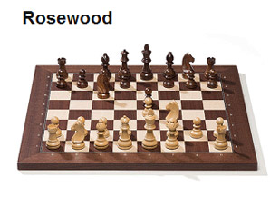
Goals
To create a portable interactive chess board where gameplay will be fully automated.
Each piece will be moved by a claw suspended above the board
Person vs. Computer

Slide 3
Specifications
90% chess piece movement accuracy
Total weight <100 lbs
12”x12” playing grid

Slide 4
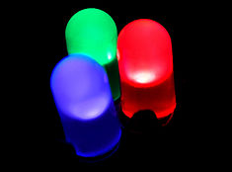
Features and Functions
LED lights will be used to light up the squares on the board
RGB, individual squares, communication with the user(s)

Slide 5

Features and Functions
Player modes:
1.) Player vs. Computer
2.) Player vs. Player
3.) Computer vs. Computer

Slide 6
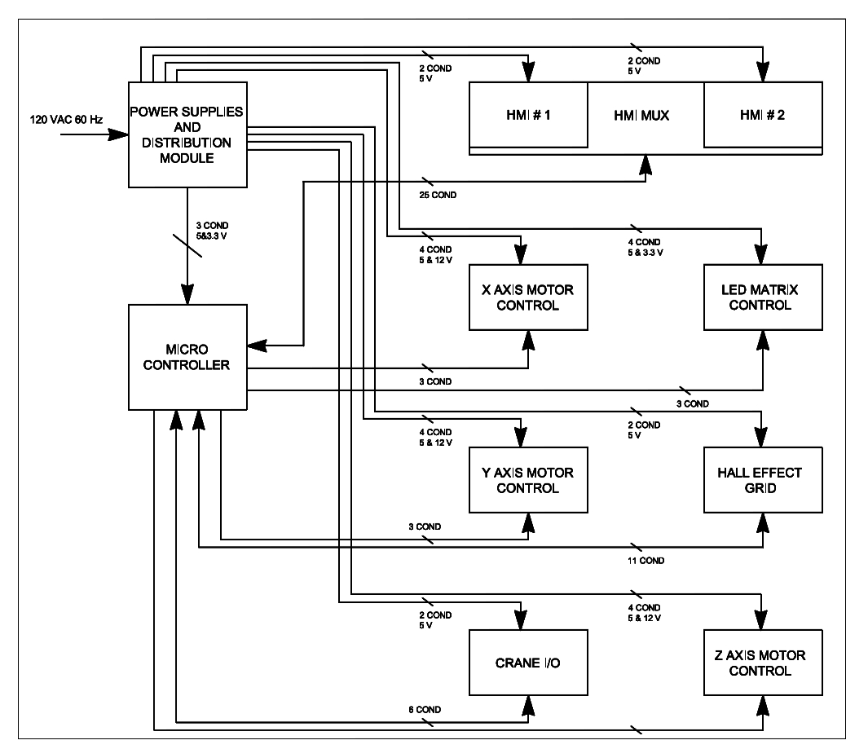
Block Diagram

Slide 7
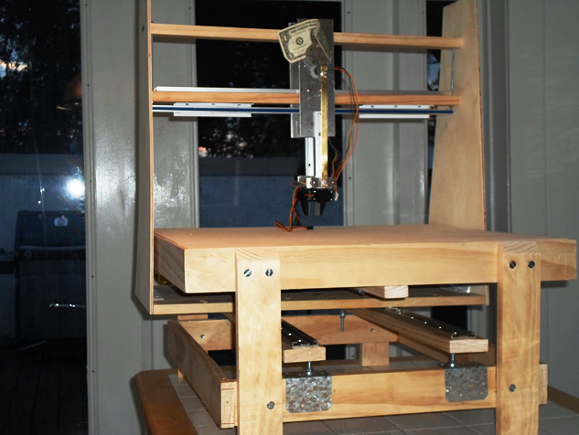
Physical Chess Table

Slide 8
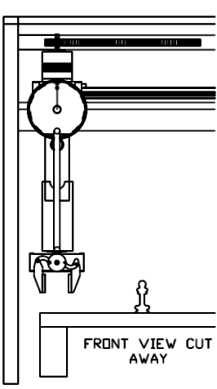
Mechanical
Three Motion Axis
One Gripper
Sliding A Frame Structure
Overhead Gantry
Stability and Consistent Repeatable Motion Control Needed

Slide 9
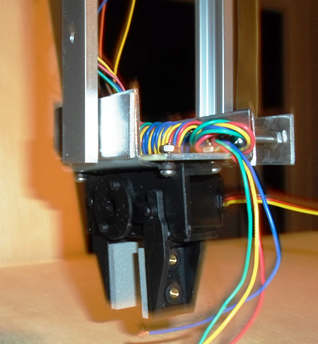
Gripper Claw
Gripper with Servo Goals
Purchase gripper and servo this was not a design item
One Micro Controller I/O output to command gripper open and closed
Pulse width command signal with a 20 ms period. The pulse on time will very to open and close the gripper.

Slide 10
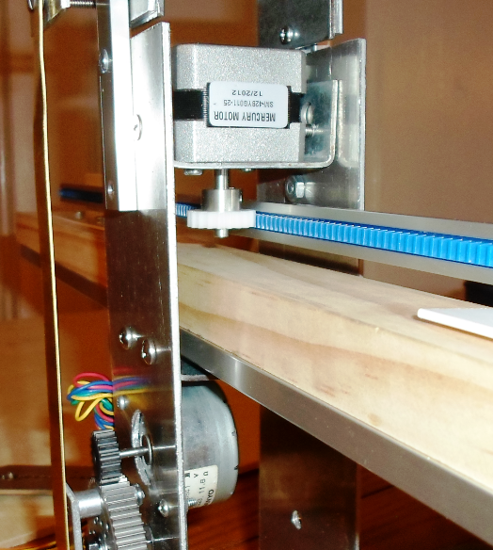
Stepper Motors
Two Motor Types both 12 Volt Bi-polar Stepper Motors.
Torque Value for X & Y Axes rated at 2.4Kg*cm
Plan to Measure Force, Coefficient of Static and Dynamic Friction of our system

Slide 11
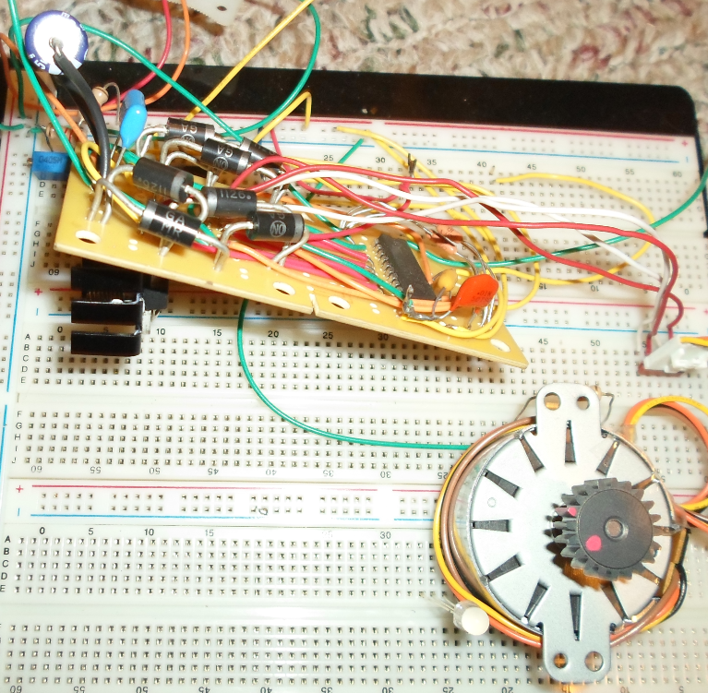
Motor Control
Design Goals
Single Modular Design for all Three Axes
Easy to bread board Avoid surface mount technology
Must be practical to install heat sink
Minimize micro controller I/O count
Based on proven reference design

Slide 12
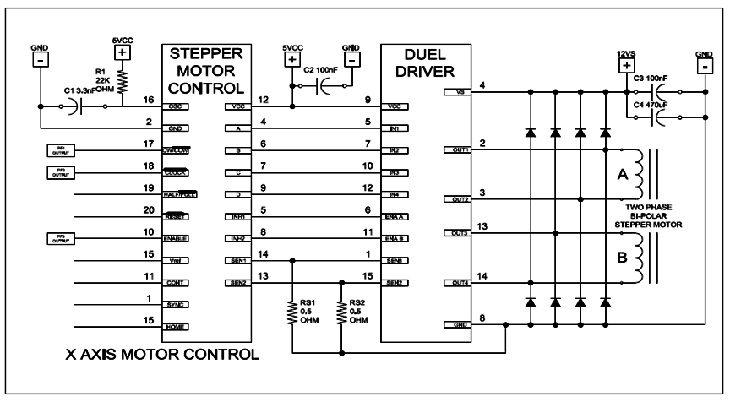
Motor Control Schematic
L297
L298

Slide 13
Stepper Resolution
Each step equals 1.8 degrees of angular displacement.
200 steps per revolution
No feedback needed with stepper motors
X and Y axes have the same size gears and motors, so the scaling is the same
Z axis needs one half revolution of the large gear.
1REV = 1.978in 1Step ≈ .01in

Slide 14
Motion Control Circuits
X and Y Axes Over travel switches
E-Stop Switch
X,Y and Z Axes Home Sensors to provide the micro controller with a starting reference.
Gripper Open and or Closed sensor
Home and Gripper position sensors Digital Discrete Inputs

Slide 15
LED Grid
Purpose:
The grid of LEDs have a dual function, to add a lighting aesthetic to the board and visual cues for the player based on what is happening in the game.
The board itself does not have painted on black and white squares, like most chess boards, but rather it has the LEDs under the board turn on or off in a checkerboard pattern to make the distinction between squares.
The visual cues the LEDs give the player is to change color based on whether or not a piece is in danger of being taken, if one of the players are in check, or if a pawn has changed into another piece via the opponent’s side of the board.

Slide 16
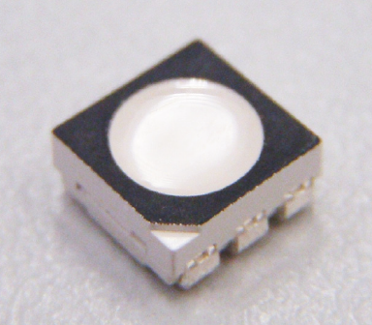
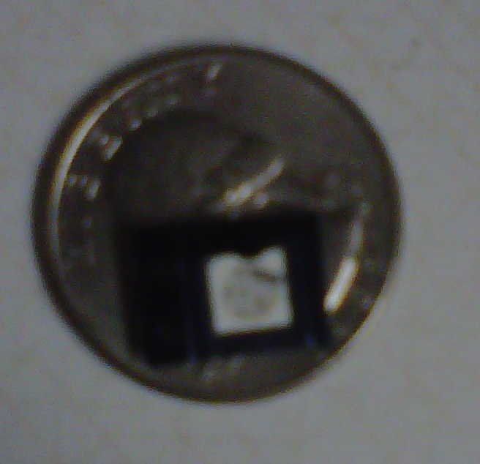
LED Grid
Parts to use:
MAX7219 8X8 grid LED Driver
Plcc6 3 in 1 SMD LED

Slide 17
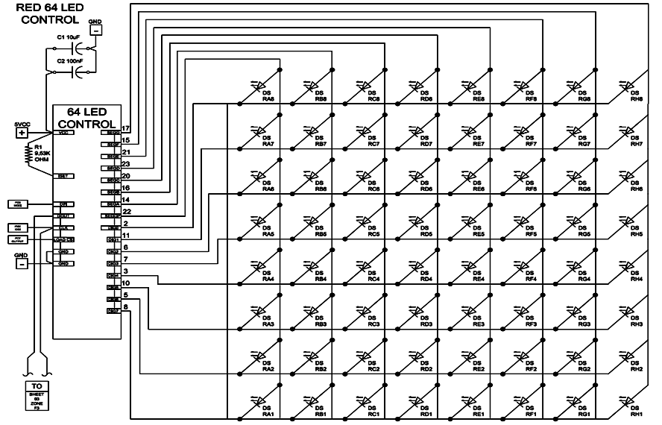
LED Grid

Slide 18
Hall Effect Sensor Grid
Purpose:
For the microcontroller to understand where the chess pieces are Hall Effect sensors are put under the board and grave yard.
The sensors will read whether or not the chess piece, which has a magnet embedded into it, is on particular squares.

Slide 19
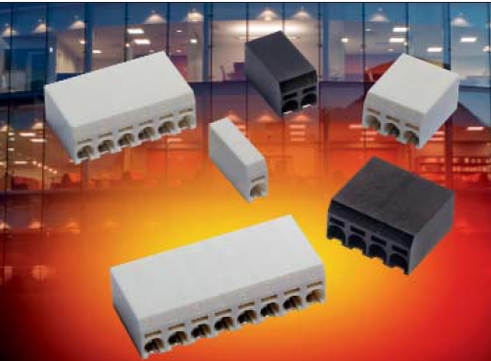
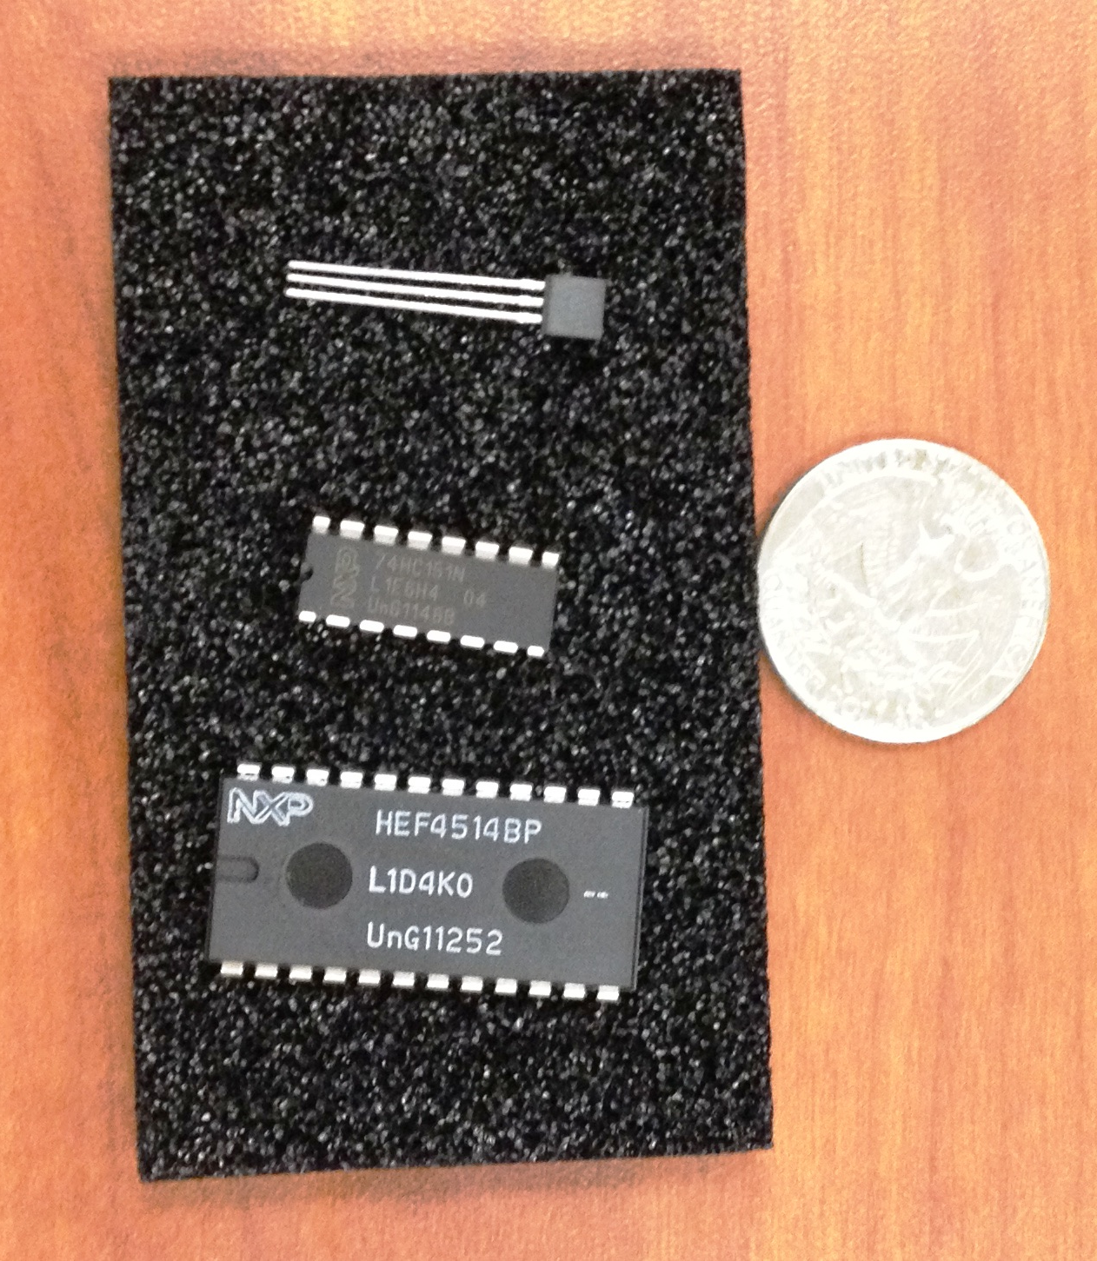
Hall Effect Sensor Grid
Parts to use:
4 to 16 Demultiplexer
8 to 1 Multiplexer
Uni-polar linear Hall Effect sensors
4 way Discrete Wire-to-Board surface mounted terminal blocks
1kΩ resistors
Schottky Diode

Slide 20
Hall Effect Sensor Grid
Specifications:
4 to 16 Demultiplexer(HEF4514):
V_{DD} ≈ 5VDC
A₀-A₃, EL = 5VDC
O₀-O₁₅ ≈ 5VDC
E(NOT), V_{SS}= 0V
8 to 1 Multiplexer(74HC151N)
2.0 ≤ V_{CC},S₂-S₀ ≤ 6.0
2.0 ≤ I₀-I₇ ≤ 6.0
E(NOT) = 0V
Uni-polar linear Hall Effect sensors(OH090U):
V_{cc} , V_{out}= 5VDC
Magnetic Hysteresis = 10 to 100 Gauss

Slide 21
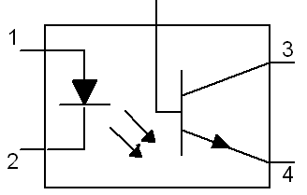
Hall Effect Sensor Grid
Is an Optocoupler Needed?:
4 to 16 Demultiplexer(HEF4514):
An optocoupler will be required to communicate with Microcontroller due to a voltage requirement of the demultiplexer being greater than 3.3VDC.
8 to 1 Multiplexer(74HC151N)
Can directly communication with the Microcontroller due to 3.3VDC being within the multiplexer’s operating range.

Slide 22
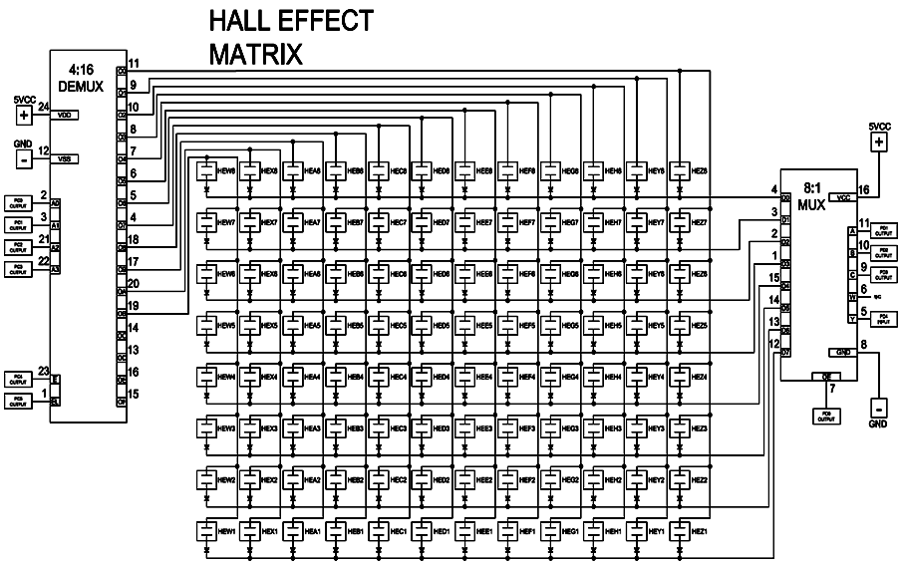
Hall Effect Sensor Grid

Slide 23
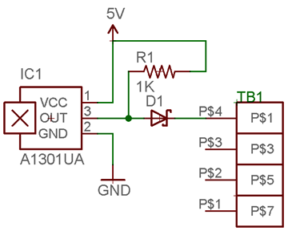
Hall Effect Sensor Grid
Hall Effect Sensor Modular Design

Slide 24
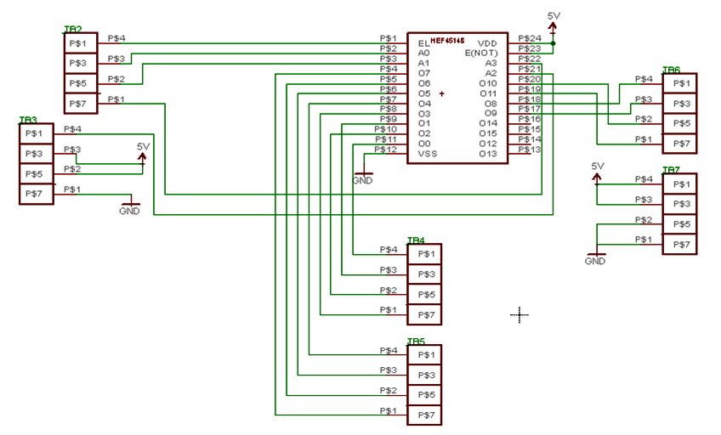
Hall Effect Sensor Grid

Slide 25
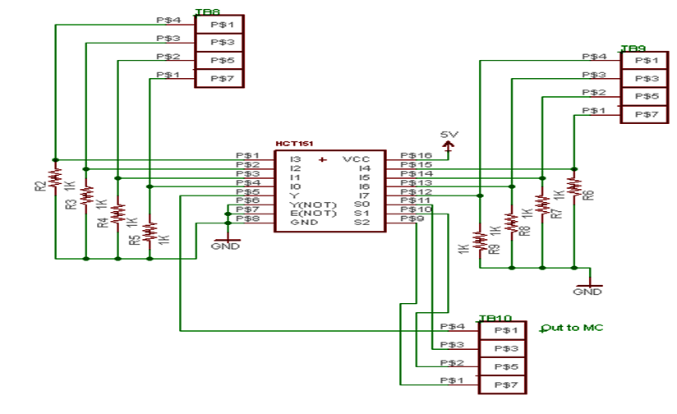
Hall Effect Sensor Grid

Slide 26
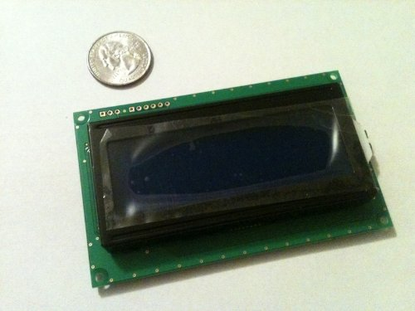
User Interface
Displays messages
Prompts the user
Informs the user
Will have buttons for input selections
Serial LCD Module 20x4 Blue with White Backlight for Arduino

Slide 27
Microcontroller Requirements
Must run an onboard minimalist chess engine
Large development community
Easy access to dev tools.

Slide 28
Microcontroller Specifications
60 I/O pins
4 hardware timers
4 USART
60 KB flash
4 KB SRAM

Slide 29
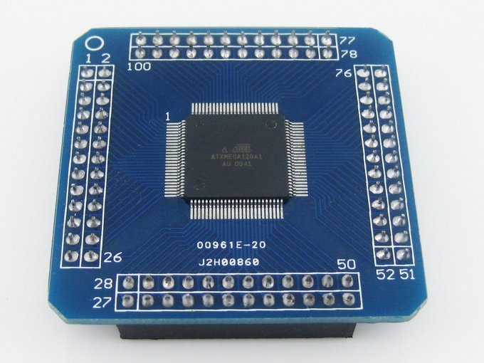
Xmega128A1
8KB SRAM
78 I/O pins
8 UART for Serial
8 Timers for PWM
128KB Flash memory
AVRFreaks support community
Atmel Tutorials, Atmel software suite

Slide 30
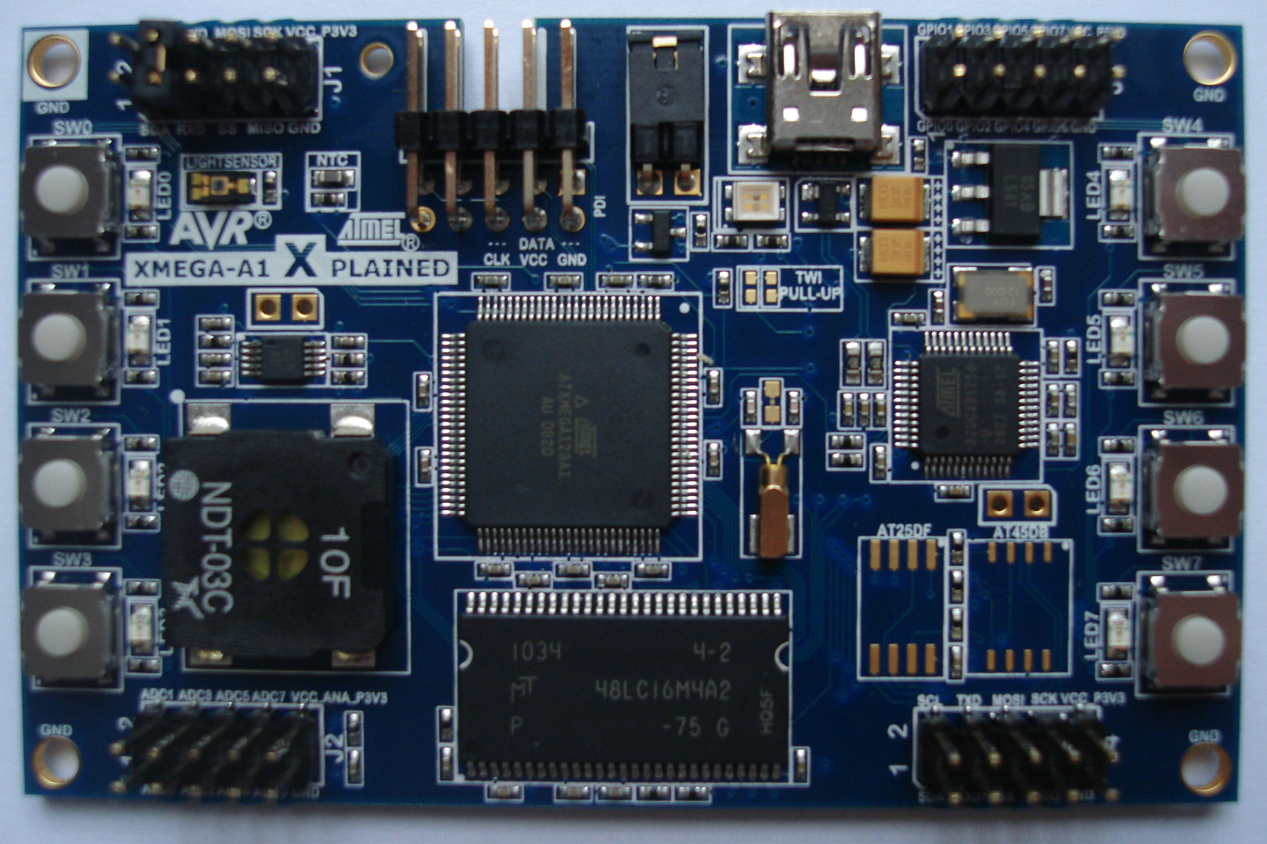
Development Tools
A1Xplained Board
For testing individual components
Atmel Studio
USB gateway
Had to program using Atmel FLIP
No debugging

Slide 31
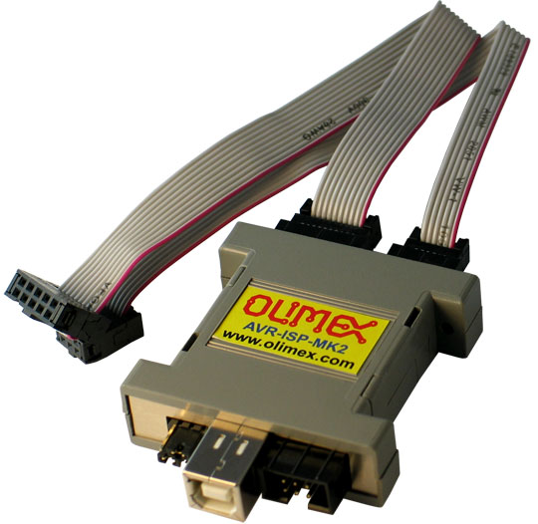
In System Programming
Ordered an AVR-ISP-MK2
Program in system with PDI
Also has debugging capabilities

Slide 32
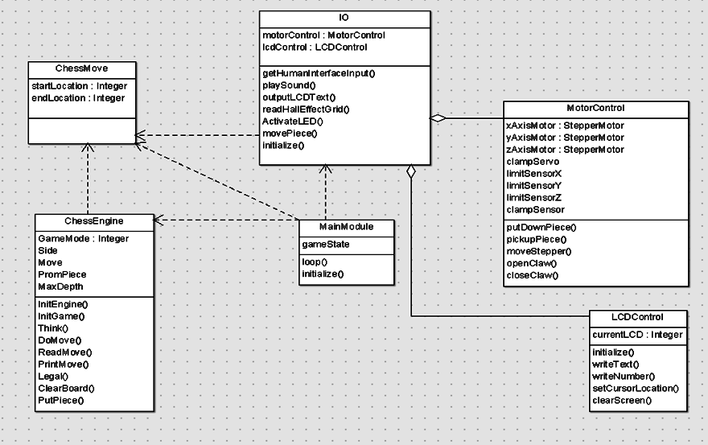
Software

Slide 33
Main Module

Slide 34
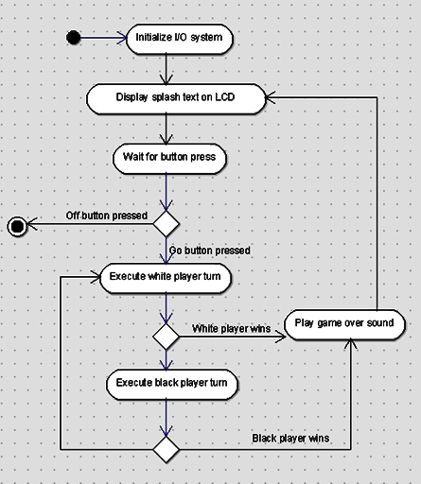
Main Module
Use only high level method calls
Describes high level gameplay process
Orchestrates interaction between I/O and Engine
Translates “moves” between chess engine and I/O module representations

Slide 35
Chess Module

Slide 36
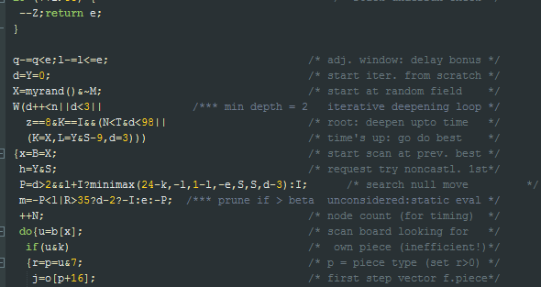
Chess Module
Contains internal state of chess game
Accepts player moves and creates AI moves
Should use < 4 KB RAM
Micro-Max open source chess engine
Smallest chess engine in the world
Our goal was not to understand, but to interface.

Slide 37
I/O Module

Slide 38
I/O Module
Contains functions to interface with individual I/O devices
Exposes high level interface to main module

Slide 39
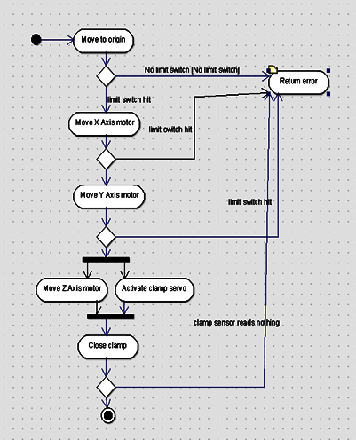
Motor Controller
All motor I/O functions grouped together
High level interface including “move piece”

Slide 40
Software Progress
Programed A1Xplained over USB
Created scaffolding for whole project
Ported and created interface to chess engine
Have claw servo working
We have single stepper motor to move
Created test suite for individual component testing
Got LCDs working with Arduino

Slide 41
Anticipated Problems
Motor controller
Currently runs with 1 of 4 wires disconnected
Changing I/O configurations as we go
Repeatability
Integration issues
Actually putting everything on the board

Slide 42
Test Plan
We have developed a written test plan
Acceptance Test Plan (ATP) where the Acceptance Test Results (ATR) are the final test results

Slide 43
Budget to Date

Slide 44


Sponsors
Igus
Allied Electronics

Slide 45

Total Spent to Date
$346.90

Slide 46
Total Progress

